Slide 1
Art Resources
For use on Google Classroom, at home and at school!

Slide 2
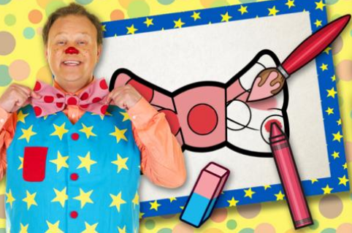
EYFS
Cbeebies – Make and Colour
https://www.bbc.co.uk/cbeebies/makes
Full of creative makes and easy to follow draw
alongs, featuring some of our favourite characters
like Peter Rabbit and The Go Jetters!

Slide 3

BBC Bitesize – KS1
https://www.bbc.co.uk/bitesize/subjects/zyg4d2p
KS1 Art and Design - BBC Bitesize
Topics on
Drawing
Sculpture
Painting
Textiles

Slide 4

BBC Bitesize – KS2
https://www.bbc.co.uk/bitesize/subjects/zn3rkqt
KS2 Art and Design - BBC Bitesize
Lessons full of videos, quizzes and practice activities to help you with home learning.

Slide 5
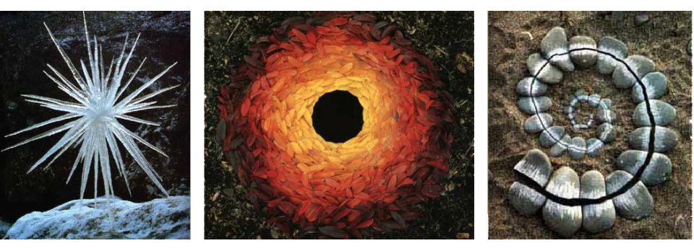
Year 1 – Andy Goldsworthy
https://www.bbc.co.uk/bitesize/clips/zh4wmp3
Use the link above to find out more about Artist Andy Goldsworthy, where he talks about and demonstrates creating artwork in a natural landscape using natural materials.

Slide 6
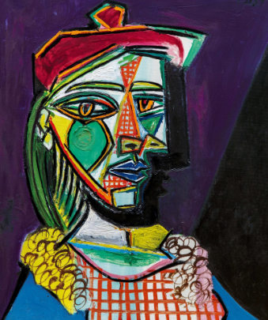
Year 3 – Pablo Picasso
https://www.bbc.co.uk/bitesize/clips/z7b9jxs
Use the link above to find out more about the artist Pablo Picasso, showing his paintings and sketches and talking about the inspiration for his work.

Slide 7
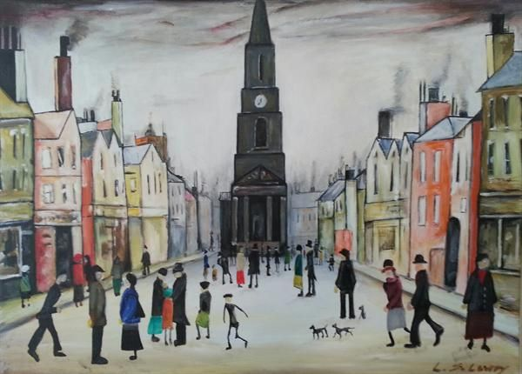
Year 6 – L.S.Lowry
https://www.bbc.co.uk/bitesize/clips/z4kq6sg
Use the link above to find out more about Lowry's style of painting and choice of subject matter narrated by Lowry himself. The artist explains his technique, how he selects his subject matter and what he is trying to capture through his work.

Slide 8
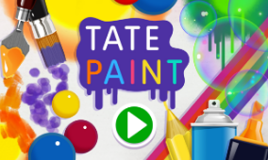
General Resources
https://www.tate.org.uk/kids
Tate Kids
A great resource to be used for Primary children of all ages.
With ‘Make’, ‘Games and Quizzes’ and ‘Explore’ section – great for providing ideas of art projects and finding out more about artists.

Slide 9

The Great Big Art Exhibition
https://firstsite.uk/
Artists and galleries across the UK are getting together to encourage us to create a community art gallery in our front windows (or similar place). Sir Anthony Gormley is the first artist to set the challenge of creating a piece of art base on the theme ‘animals’. Anyone can get involved.
The Great Big Art Exhibition will run from Thursday 28 January until April. Information and an activity pack are available from The Great Big Art Exhibition - Firstsite

Slide 10
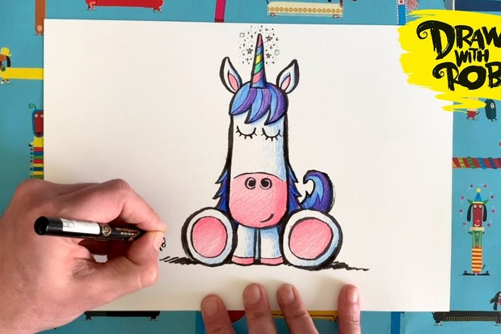
Draw with Rob Biddulph
www.robbiddulph.com/draw-with-rob
Rob Biddulph, is an illustrator author. Bob says ‘Everyone can draw’ and he shows you how! Rob has posted some draw-along videos that parents and carers can watch with their children and, hopefully, make their own pictures too. You can draw along and send Rob the results using the hashtag #DrawWithRob

Slide 11

Oak National Academy
https://classroom.thenational.academy/subjects-by-key-stage/key-stage-1/subjects/art KS1
https://classroom.thenational.academy/subjects-by-key-stage/key-stage-2/subjects/art KS2
Oak National Academy to create new Art, Craft and Design lessons for Key Stage 1 and 2. They are engaging and accessible, and fantastic for both remote and in-school lessons.

Slide 12

London South Art Hub
https://www.londonsoutharthub.org/learn
The aims of the Hub are to provide a platform for Art lessons and activities for children and young people. The Hub also serves as a platform for young artists to share their work.
Easy to follow, expert led art lessons!

Slide 13
We are Teachers
https://www.weareteachers.com/best-kindergarten-art-projects/
We are Teachers have compiled '40 Kindergarten Art Projects That Inspire Creativity in Every Student’. There are links to a range of other websites with full details for the projects, which can be adapted for older learners.

Slide 14
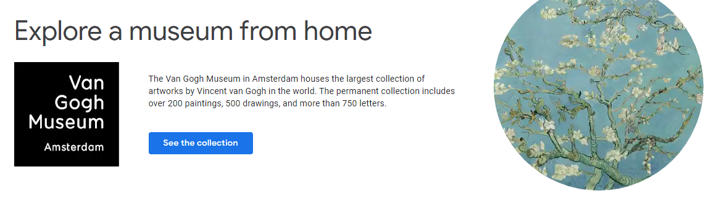
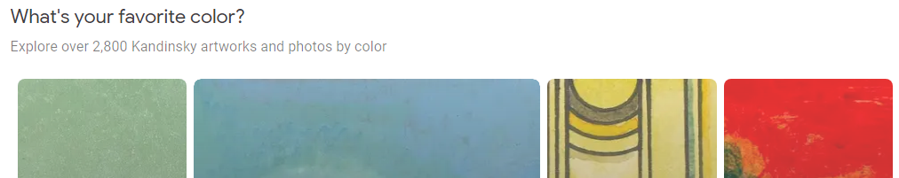
Google Arts and Culture
https://artsandculture.google.com/
This is an amazing resource for all sorts of things, from virtual museum tours, to exploring artists and their work, to sourcing contextual referencing for projects. It is an amazing for research for KS2.

Slide 15
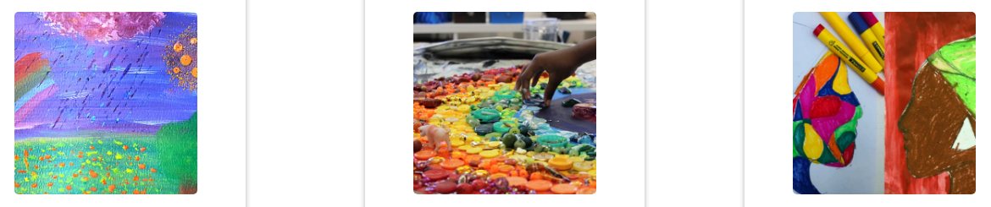
The Art Room – Place 2 Be
https://www.place2be.org.uk/our-services/parents-and-carers/coronavirus-wellbeing-activity-ideas-for-families/activities-from-the-art-room/
During the lockdown period, the Art Room team created a series of free projects for primary aged children to make at home or school together with parents, carers or teachers.

