Slide 1



Governor
Profiles

Slide 2
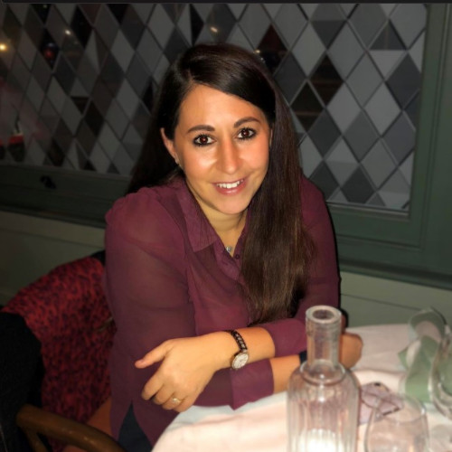
CHAIR OF GOVERNORS: KATIE FOX
I’ve been a Parent Governor since February 2021 and am Link Governor for PSHE and SMSC. I became Co-Chair of Governors in September 2022 and Chair of Governors as of September 2023.
My twins are in Year 4 at Howe Dell. Since they started nursery in 2019, I have enjoyed supporting the PSA with the amazing calendar of events and activities they plan for the Howe Dell family each year.
I am passionate about providing a happy and secure environment for all children to grow up in and believe in the importance of looking after mental health and wellbeing from a young age.
I currently work full time as Marketing Manager for the Ideal Home Show and The Cake & Bake Show. Having worked in PR & Communications for over 15 years specialising in events and lifestyle brands, I have experience with managing large scale events, budgets and strategic decision making.
Behind the scenes, I enjoy spending quality time with family and friends, be it fun days out or cozy days in. As a family we love the outdoors, we’re always listening and dancing around to music, and we’re a family of foodies!

Slide 3
DR NICOLA WINCH
I joined the Governing Board as a Co-opted Governor in October 2022. I am an experienced Governor and I was happy to join the team as the Special Educational Needs and Pupil Premium Governor. I am hoping that my broad experience (primary, secondary, state and Multi Academy Trust) and my independence will be an asset to the Howe Dell team.
Being a Governor allows me to combine my love of the local community, education (tutor at Oxford University during my Biochemistry PhD; volunteer with vulnerable children for >30 years) and my background in Strategy and Governance. Our three primary-aged children who have Special Educational Needs (SEN) and are not enthusiastic learners have really strengthened that commitment!
I love to spend time with my family and friends hiking, playing games, doing puzzles (jigsaws, Sudoku, logic problems), building LEGO kits, reading or watching films.

Slide 4
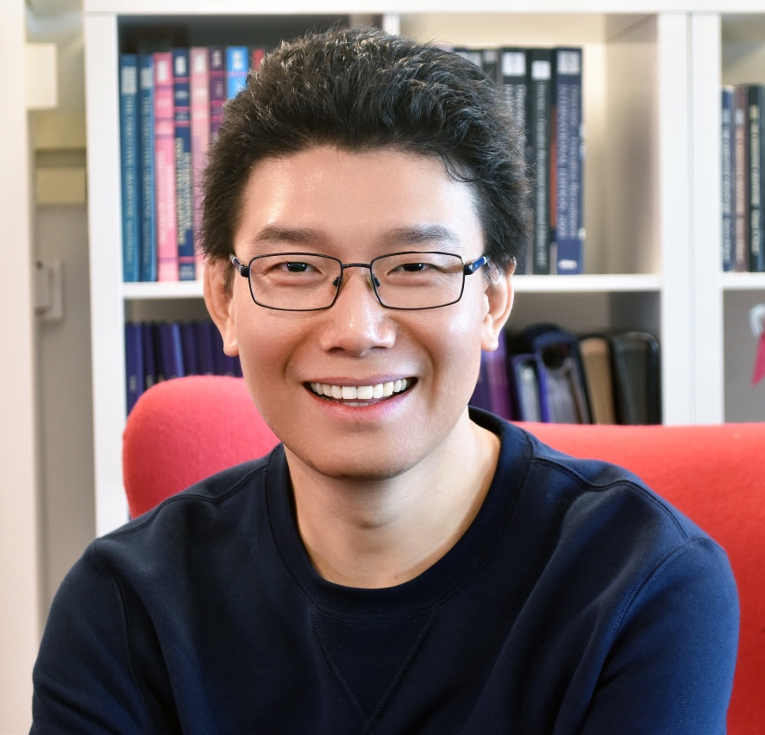
DEPUTY CHAIR OF GOVERNORS: RICK XU
I have been with the Governing Board since 2017 and later appointed as Data Protection Officer. Now acting as Deputy Chair of Governors and Link Governor for Maths, I am also chairing all Finance & Resources FGB meetings.
While I am not around the school, I am the Chief Digital Officer of a media publisher based in Welwyn Garden City thriving for digital transformation. I still have one child with the Howe Dell family and two proud ex-pupils who both enjoyed their fantastic ten years here right from the day care. Howe Dell is a unique community school with great cultural diversity and we are here to write the next outstanding chapter, together.

Slide 5
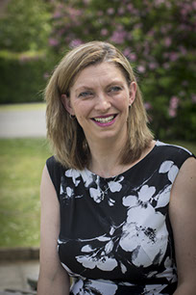
HEADTEACHER: TRACY PRICKETT
As the Executive Head teacher, it is essential that I provide the Governing Board with the relevant information to enable them to effectively undertake their statutory roles.
I have lived in Hertfordshire all my life and I commenced my teaching career in 1998. During my teaching and leadership career, I have had the opportunity to work with and for some inspiring leaders who have enabled me to shape my own leadership.
I spent eighteen years at The Reddings Primary and Nursery School in Hemel Hempstead. I started in 2003 as a class-based Deputy Head and I joined the Governing Board. In January 2006 I became the Head Teacher. Many significant life events occurred during this time, I became a wife and a mother. My eldest son is at secondary school and then there are my twins!
My Head teacher role has been varied. I have led a plethora of subjects over the years, I am a Hertfordshire STEPs tutor (therapeutic approach to behaviour) and the Designated Safeguarding Lead.
I am the Chair of Primary Heads Forum which includes being a member of Schools' Forum (where all the financial decisions are agreed for the Local Authority) and I am the Primary Head Teacher SEND Executive board where we are making 'SEND everyone's business’
I have also had the opportunity to be a member of a primary and secondary school Governing Board. My roles have included Chair of Resources Committee and Safeguarding Governor. Learning how other settings work has enabled me to refine my working practices.
Children are at the core of everything that I do. I passionately believe children should be provided with the tools they need to 'be the best they can be'.

Slide 6
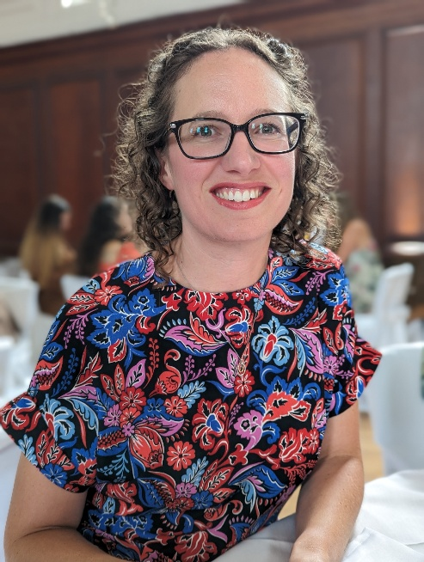
DEPUTY HEADTEACHER: HOLLY RITCHIE
I joined the Howe Dell team in September 2023 as Deputy Head teacher. I have previously worked alongside Executive Head teacher, Tracy Prickett, when she she was in post at my previous school as Interim Head teacher.
For as long as I can remember I have wanted to be a teacher and I have enjoyed working in two schools prior to joining Howe Dell, both of which have given me a wealth of experience. My first school, for three years, before moving to my previous school in Hemel Hempstead for 11 years. During my time there I progressed from class teacher to phase leader followed by Assistant Head teacher and then Deputy Head teacher. For most of my 11 years at my previous school I have been a part of the Governing Board.
At home, I have two children who keep me busy along with my husband. As a family, we enjoy travelling and spending time in the Lake District. My six year old is well trained in climbing Wainrights and it is not unusual for us to all enjoy a 15km hike. In my spare time I enjoy using my spin bike or treadmill - which are yet to become a clothes horse!

Slide 7
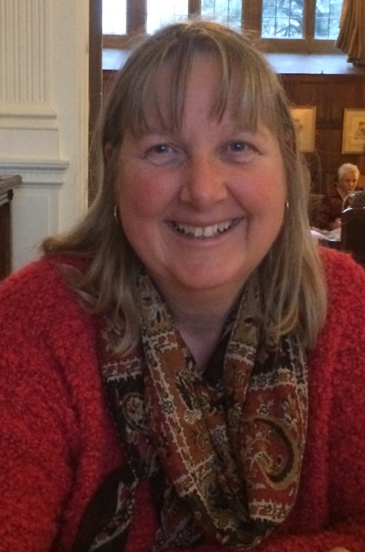
JULIA ELLIS-HALL
I have been a Governor on Howe Dells Governing Board for the past 13 years, serving in many roles and on different committees.
For the past couple of years I have been an Associate Governor which has enabled me to still use my knowledge, skills and experience for the benefit of the school, and to help my fellow Governors, without having the responsibility of being involved in the crucial day to day operations of the Governing Board.
In my spare time I love being able to spend time with my family and friends, and enjoy watching musical theatre productions. I am also involved working backstage for local societies. I am a fully participating member of the Howe Dell School Community, and strive to support the School where possible.

Slide 8
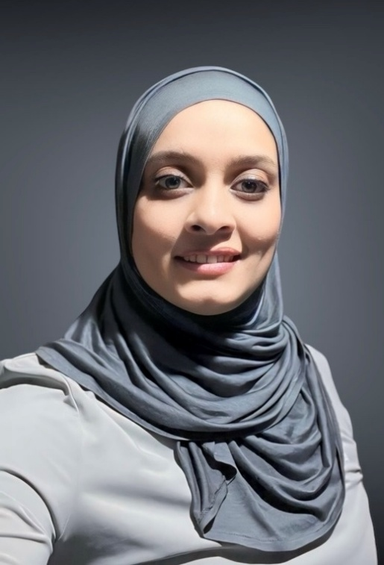
KASHIFA SALEY
I joined the Full Governing Board in November 2019.
I currently serve as both the Link governor for PE as well as the Safeguarding governor.
I have three children who have been a part of the Howe Dell family from the Baby Room in Day Care all the way through to Year 6. It’s been amazing to see them grow and develop as they progressed through each year.
I previously served a term on the FGB as a parent governor and now serve as a community governor.
Being a Governor brings with opportunities to get involved, support the school and all the staff and really make a difference especially for the children, to make the school the best it can possibly be.
I work in IT for a Global organisation. In my spare time, I love baking and spending time with family and friends, enjoying good food.

Slide 9
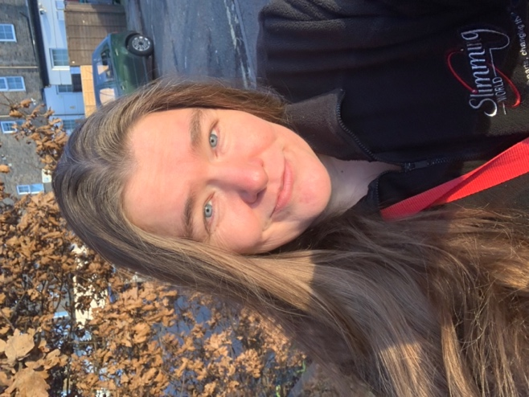
AMY JEFFERIES
Hi my name is Amy Jefferies, parent Governor and have been a part of the Howe Dell Family for 12 years! I am part of the the Day Care Committee.
I have 4 children 3 that have gone all through Howe Dell and one that is still in the school.
I am passionate about supporting the school and in my spare time I love reading and swimming.
I also run the local Slimming World groups in Hatfield and support a team of consultants as the team manager for Welwyn Garden City, Hatfield , Wheathampstead and Harpenden .

Slide 10
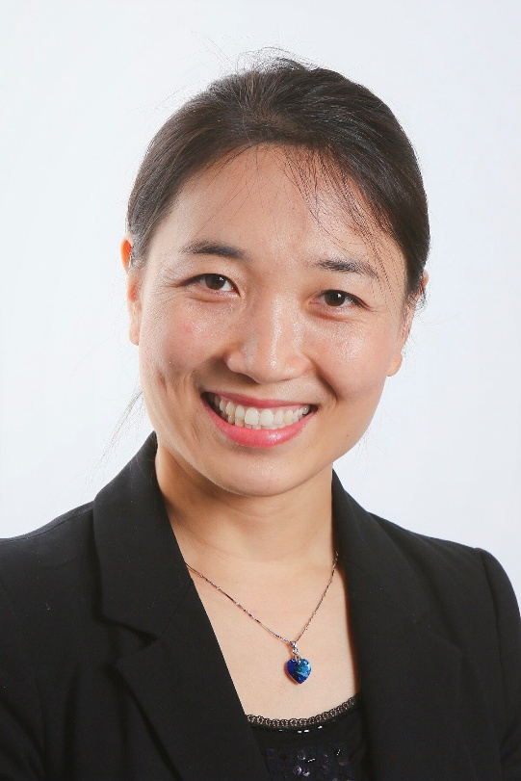
SUZIE (XIANGPING) DU
I am a new parent governor formally joined the Governing Board in March 2024. I am a mum of two: one in Year 3 and the other in Year 5 at Howe Dell School.
I work at the University of Hertfordshire Business School as the Associate Dean, Postgraduate Student Experience. I have been working at the University of Hertfordshire (UH) since I've completed my PhD in Education in 2009. In the past 14 years with UH, I have worked on various roles around learning, teaching and student support. I love working in educational institutions and I am passionate about student experience. I truly believe "education changes lives" and the school is where these changes take place.
I am workaholic but I do love music and travelling and enjoy the company of my family.

Slide 11
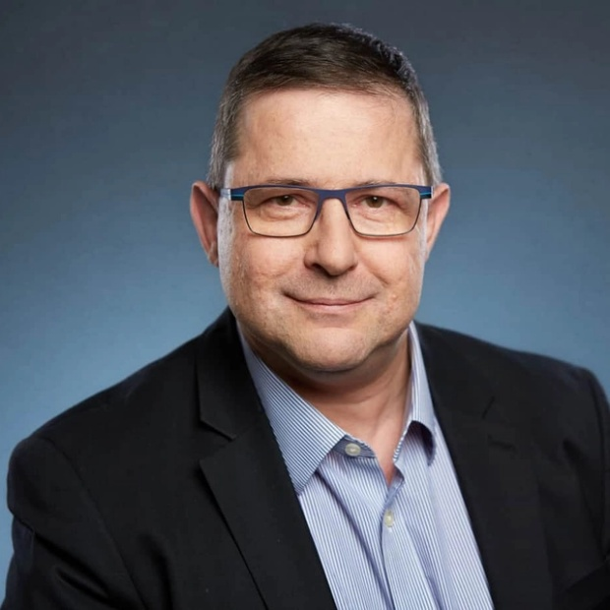
JASON LEVY
I feel privileged to serve as a Parent Governor at Howe Dell School and joined the Governing Board in April 2024. For over twenty years I’ve worked across both private and NHS healthcare settings - first as a clinician, and later as the Head of Audiology of a small company supporting ten registered health professionals. Along the way I’ve learned how to build strong teams, manage budgets responsibly, and deliver gold standard healthcare - all skills I now bring to the school’s governing body. I also have a special interest in SEND as a parent of a son with ASD, and understand first hand the importance of every child's social emotional wellbeing to their success in education and personal development. I love to spend time with family and friends, walking, playing badminton, building LEGO kits with my son, singing and watching films.
What I value most is delivering high-quality services. Whether it’s ensuring rigorous standards in clinical care or supporting our school community with clear processes and attention to detail, I believe excellence in delivery creates the best outcomes for everyone involved. I’m passionate about creating an environment where every child feels safe, supported, and inspired to learn.
I’m eager to apply my practical experience - balancing rigorous standards with compassion - to help Howe Dell continue flourishing. By working collaboratively with staff and fellow governors, I hope to ensure each child’s years here are both enriching and memorable.

Slide 12
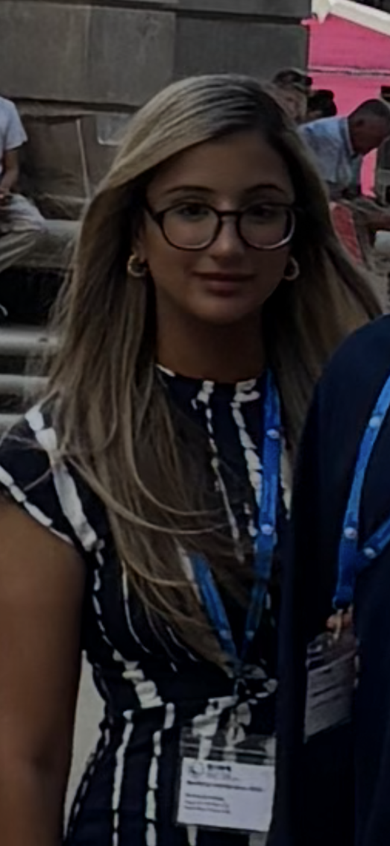
DR. ANISAH ISHTIAQ
I am a Co-opted governor, elected by the governing board for my skill set. I work as a doctor in general practice in north London and have a specialist interest in medical education with a wider passion for education as a whole and inspiring the next generation.
As a parent, I have two sons, one of whom currently attends Howe Dell Nursery and previously attended Howe Dell Daycare – so we have been part of the Howe dell family for some time!
I have a lot of experience in mentoring and educating and I am deeply committed to supporting Howe Dell pupils in achieving their full potential, helping them grow in confidence develop a love of learning and prepare for future success.
Outside of my professional and governor roles, I enjoy reading and exploring the outdoors.

