Slide 1

Welcome to Year 4
4.1: Mrs Mehmet, Mrs Kiely, Mrs Smith, Miss Hart
4.2: Miss Lass, Miss Foster, Mrs Burr, Miss Hart
PPA (Wednesday morning/afternoon): Miss Foster

Slide 2
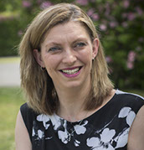
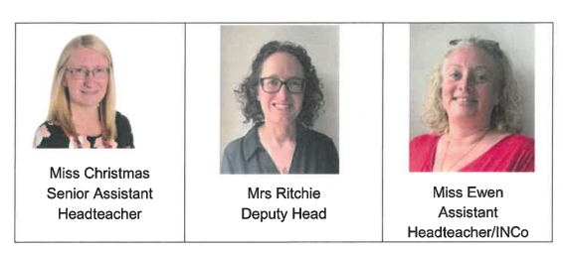
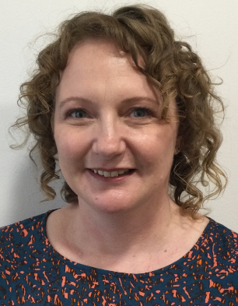
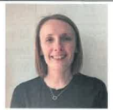
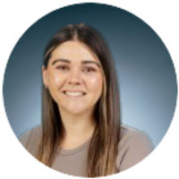

Our Leaders
Executive Headteacher
Mrs Wall
Mrs Micklewright
Assistant Head

Slide 3
The school day:
Class doors open at 8.35 and close at 8.45 for registration
Break time is from 10.30 to 10.45am
Lunch is from 12.25 to 1.20pm
School finishes at 3.15pm
Our PE day is Tuesday and Thursday
If you need to contact us our year group email is: Year4@howedell.herts.sch.uk
You may also leave messages with the school office

Slide 4
The essentials:
Please:
Make sure your child is on time each day so that they are ready to learn.
Ensure that your child’s suitably sized school bag contains all that they need for the day ahead, including a well-stocked pencil case (reviewed and replenished throughout the year). Pencil cases need to fit in their school trays.
Provide your child with a named water bottle.
Ensure that your child has plimsolls in school at all times. They are asked to change into them each time they come into school.
Print/label your child’s name on all of their clothing.

Slide 5
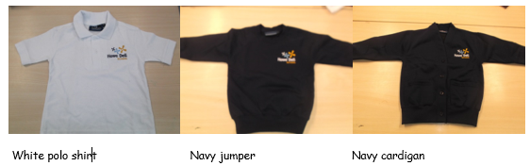
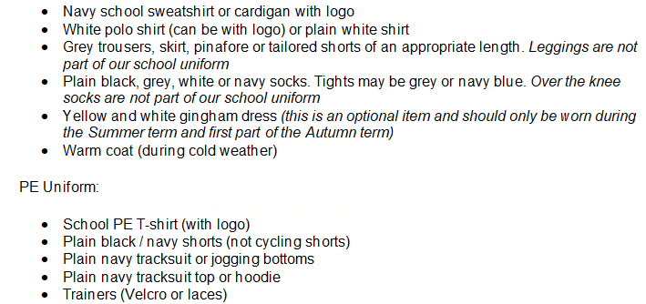
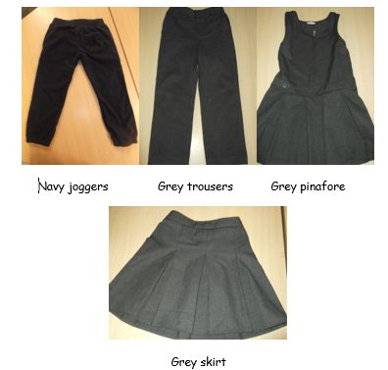
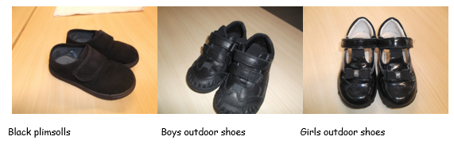
Uniform

Slide 6

Golden Expectations

Slide 7

Reading
85% of the school curriculum requires reading to access it.
Your child will have an allocated reading book
Our goal with reading in Year 4 is fluency – we want children to be able to read quickly and accurately, as well as understanding what is going on
Listen to your child read their book at home
Choose a quiet time without distractions
Feedback on their reading in your child’s Reading Diary
Look through their sharing book together – this is something they have chosen for their enjoyment and for you to read to them

Slide 8



Home Learning
We will be focussing on reading (5 x 20 minutes), spellings and times tables this year for home learning. Information will be sent out weekly on a Friday
Reading linked to our wider curriculum (geography, history, science etc.) can be accessed through Curriculum Visions.
https://www.howedell.herts.sch.uk/home-learning/

Slide 9


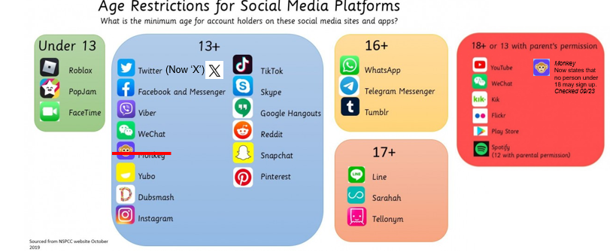
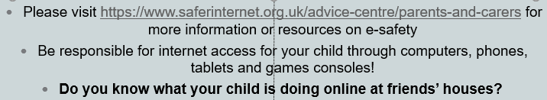
E Safety Agreement: a duty of care for parents and circulated annually at Howe Dell

Slide 10
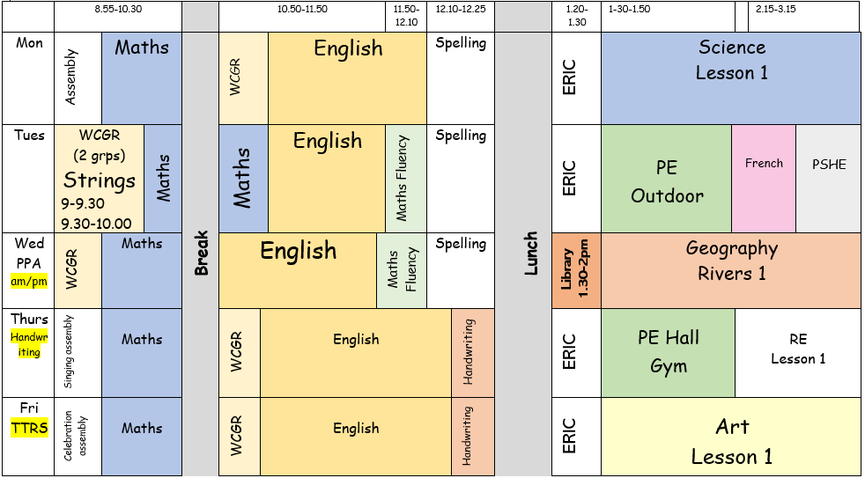
Our weekly timetable (4.1):

Slide 11
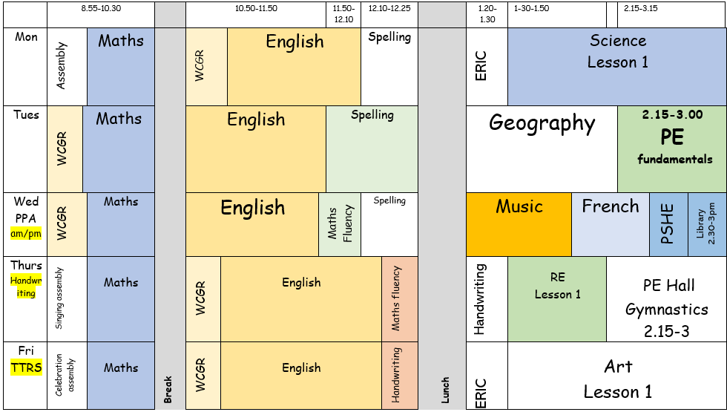
Our weekly timetable (4.2):

Slide 12

Curriculum Flyer

Slide 13
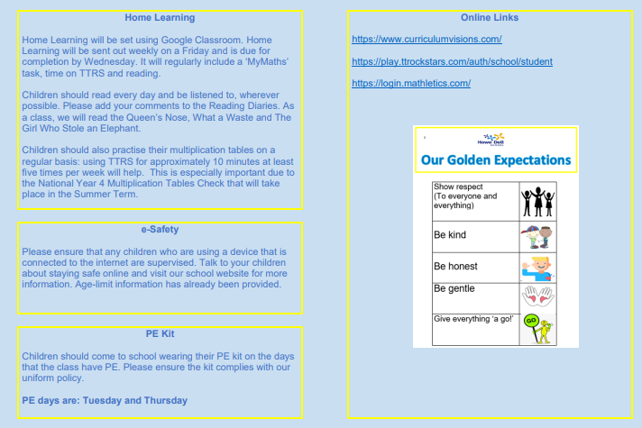
Curriculum Flyer

Slide 14

School website – where to find further information about what we are learning
https://www.howedell.herts.sch.uk

Slide 15
Parent ambassador
The purpose of the role is:
Promoting school values: Uphold and promote the core values of Howe Dell Primary School – respect, kindness, and growth. ​
Liaison between school and parents: Act as a bridge between the school and parents to facilitate open communication and understanding. Share information about school events, policies, and initiatives with fellow parents. ​
Supporting growth initiatives: Assist in the implementation of growth-focused initiatives and programs within the school community. ​
Feedback mechanism: To continuously gather feedback and suggestions from parents regarding school matters. Present constructive feedback to the school leadership team to enhance communication and collaboration. ​
Attend termly meetings: Attend meetings with school staff and fellow Parent Ambassadors once a term to discuss updates, share feedback, and to provide input on behalf of the parent community. ​
Welcoming new parents: Provide a warm and friendly welcome to new parents, helping them integrate into the school community and understand the values and expectations of Howe Dell. ​
Collaboration with school events: Actively participate in and support school events and activities, fostering a sense of community among parents. ​
If this is a role you would be interested in then please email admin@howedell.herts.sch.uk with FAO of Mrs Ritchie and Miss Christmas in the subject.

Slide 16
Do you have any questions for us?

