Slide 1

Welcome to Year 3
3.1(Miss Redwood, Mrs Galloway)
3.2 (Miss Brewster, Mrs Worsley, Ms Jorge)

Slide 2
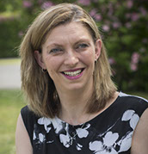
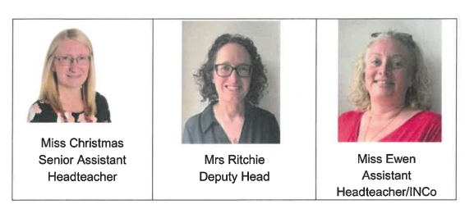
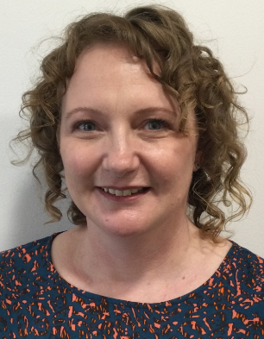
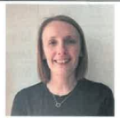
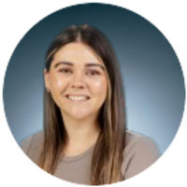

Our Leaders
Executive Headteacher
Mrs Micklewright
Assistant Head

Slide 3
The school day:
Class doors open at 8.35 and close at 8.45 for registration
Break time is from 10.00 to 10.15am
Lunch is from 12.00 to 1.00pm
School finishes at 3.15pm
Our PE day is Monday and Tuesday
If you need to contact us our year group email is: Year3@howedell.Herts.sch.uk
You may also leave messages with the school office

Slide 4
The essentials:
Please:
Make sure your child is on time each day so that they are ready to learn
Ensure that your child’s suitably sized book bag contains all that they need for the day ahead, including a well-stocked pencil case (reviewed and replenished throughout the year)
Provide your child with a named water bottle
Ensure that your child has plimsolls in school at all times
Print your child’s name on all of their clothing
Make sure they bring a fruit snack each day

Slide 5
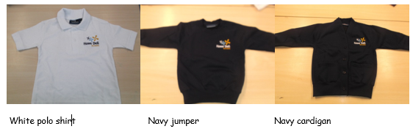
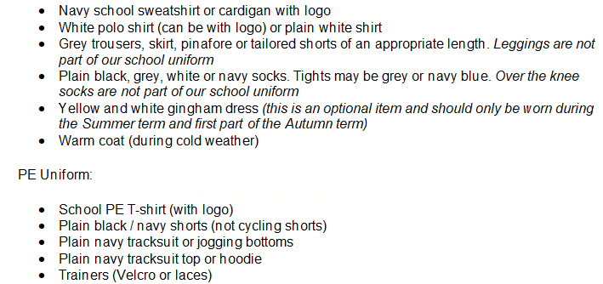
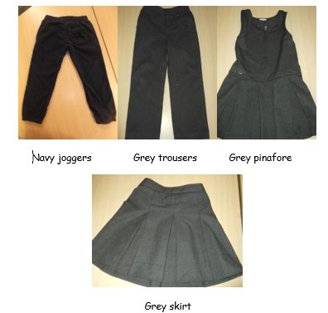
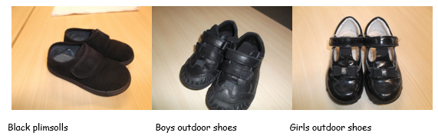
Uniform

Slide 6

Golden Expectations

Slide 7

Reading
85% of the school curriculum requires reading to access it.
Your child will have an allocated reading book on the Collins hub
Listen to your child read their book at home
Choose a quiet time without distractions
Feedback on their reading in your child’s Reading Diary- this will be checked on Mondays and Thursdays
Look through their sharing book together – this is something they have chosen for their enjoyment and for you to read to them

Slide 8



Home Learning
We will be focussing on reading, spellings and time tables this year for home learning. Information will be sent out weekly on a Tuesday starting from next half term.
Suggestions for reading linked to our wider curriculum (geography, history, science etc.) can be accessed through Curriculum Visions. Details of what to read will be put on Google Classrooms

Slide 9
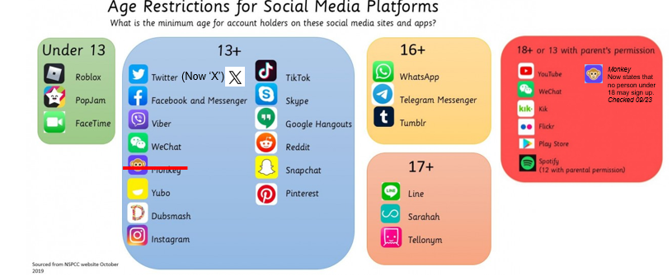
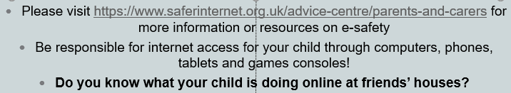
E Safety Agreement: a duty of care for parents and circulated annually at Howe Dell

Slide 10
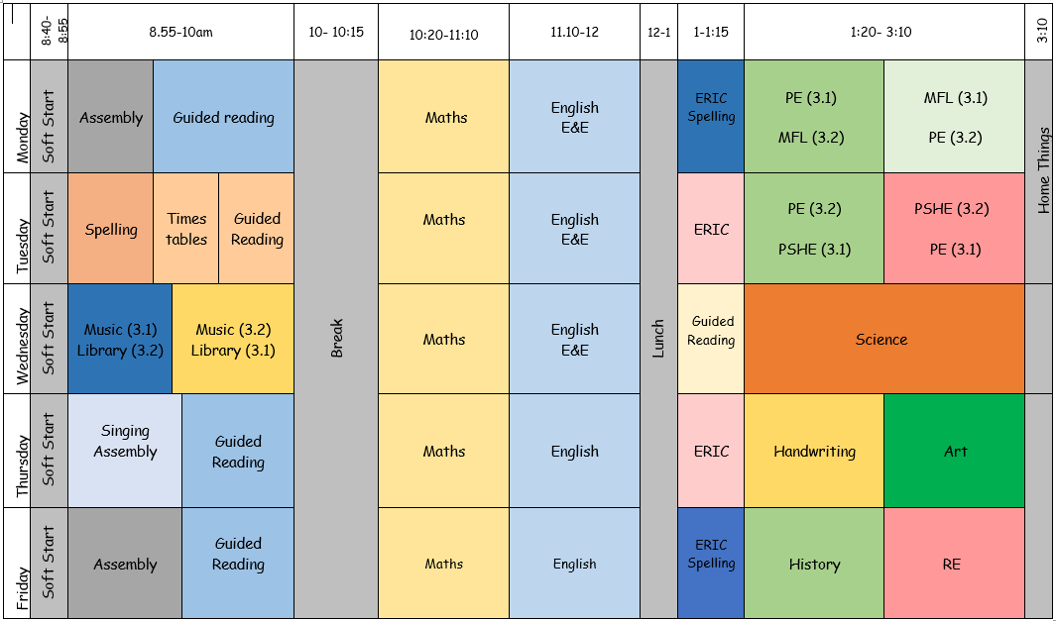
Our weekly timetable:

Slide 11
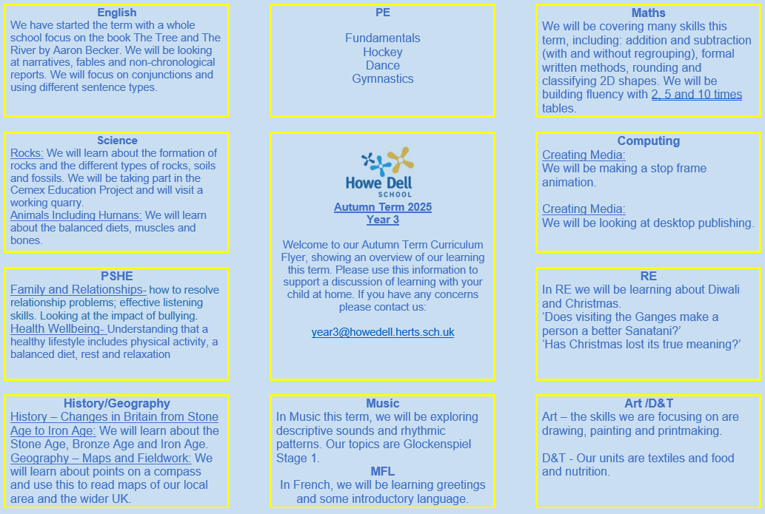
Curriculum Flyer

Slide 12
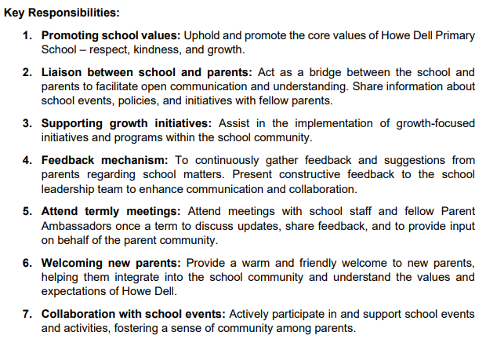
Parent Ambassador
If you are interested in this role, please email admin@howedell.herts.sch.uk with Parent Ambassador as the subject.

Slide 13
Key Dates for Year 3
  Cemex quarry trip- 24th September
  Cemex nature reserve trip- 30th September
  Celtic Harmony TBC

Slide 14
Do you have any questions for us?

