Slide 1
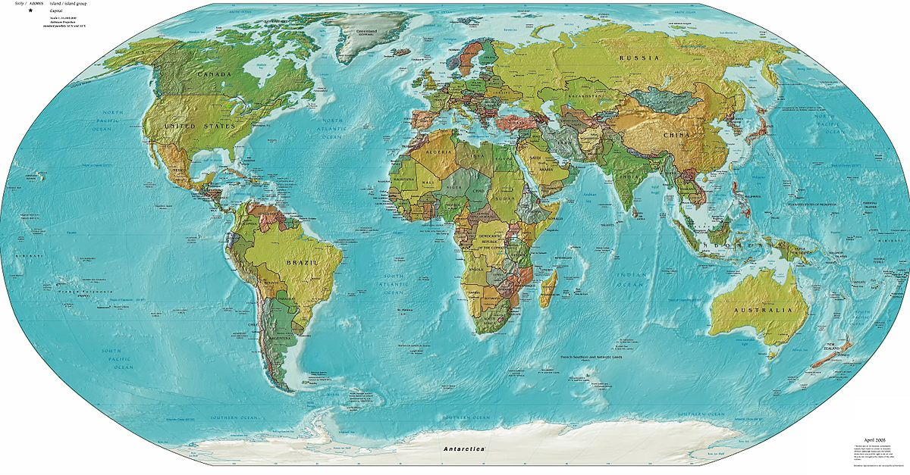
Geography Home Learning Websites
Online Geography Games:
https://world-geography-games.com/world.html
https://www.toporopa.eu/en/
Fieldwork, environment & Map skills:
https://www.ordnancesurvey.co.uk/mapzone/
http://www.woodlandtrust.org.uk/naturedetectives/schools-and-groups/
http://geography.org.uk/resources/fieldwork/fieldworkideasandresources/
https://www.wildscreen.org/year-round/kids-activities/
https://canalrivertrust.org.uk/explorers/teachers/virtual-learning
Geography & Grammar: https://www.naturalcurriculum.co.uk/
Geography & Science:
https://www.childrensuniversity.manchester.ac.uk/learning-activities/science/energy-and-the-environment/introduction/
http://www.earthlearningidea.com/home/Teaching_strategies.html
Useful Websites for Geography:
Primary Homework Help | Online Games For Kids - BBC Bitesize
https://classroom.thenational.academy/subjects-by-key-stage/key-stage-1/subjects/geography
https://classroom.thenational.academy/subjects-by-key-stage/key-stage-2/subjects/geography

